Slide 1
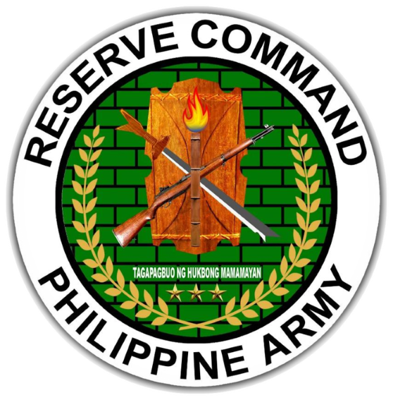
WELCOME
CADETS

Slide 2
SSG JOSEPH NIALL G ARAGON PA (RES)
UNIT DESIGNATION: BATTALION OPNS NCO
UNIT ASSIGNMENT: 504RRIBn, 1701RRIBde, PA
MOBILIZATION UNIT: 504CDC, 5RCDG, RESCOM, PA
SENIOR INSTRUCTOR FOR ARMY BASIC INSTRUCTOR COURSE (ABIC) & COMBAT LIFESAVER COURSE (CLCS) – AFP-GUNG SPP
INSTRUCTOR FOR OFFICER PROFESSIONAL DEVELOPMNENT COURSE (OPDC) – AFP-GUNG SPP
TECHNICAL INSTRUCTOR FOR HA/DR
LEVEL III CHAMELEON – CMOCEC CLASS 2 2017

Slide 3
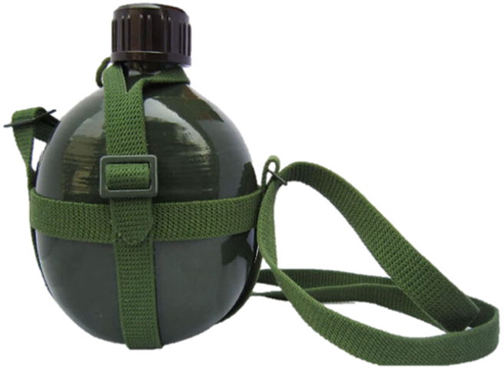
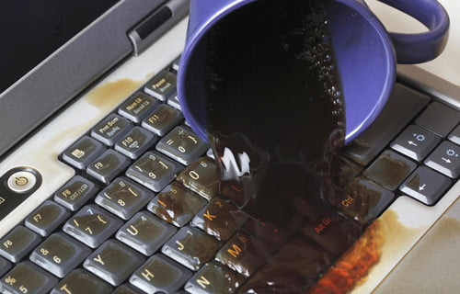
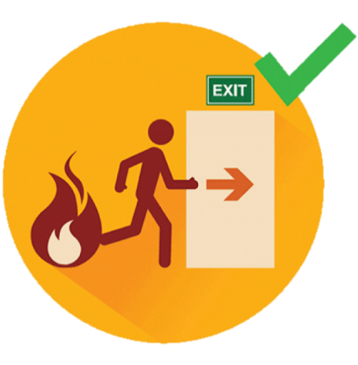
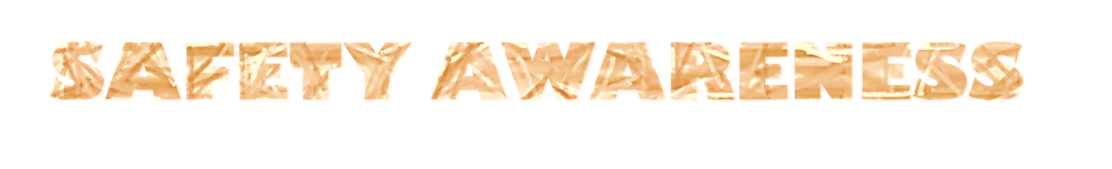
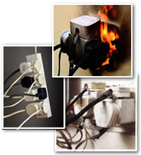


Slide 4

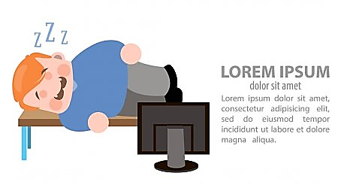
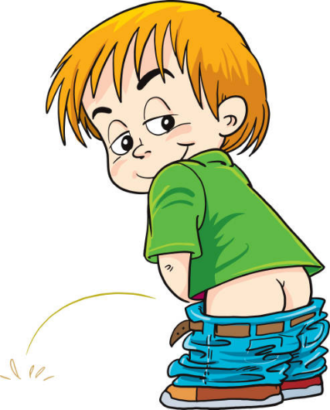
CLASSROOM RULES
Be responsible to keep yourself awake
Finds your way towards the toilet silently when you feel the urge
If there is any question, just write it down on the comment box for those who are online, for the F2F keep your question to yourself and wait to be acknowledged

Slide 5
REFERENCE
FC 1-011 ARMY CORE PHILOSOPHY

Slide 6
STANDARD CONDUCT OF A SOLDIER

Slide 7
TERMINAL LEARNING OBJECTIVE
ACTION:
Discuss and Identify the Standard of Conduct of a soldier
CONDITION:
Given in an online and face to face classroom environment, power-point presentation
STANDARD:
The student will be able to understand the Standard Conduct of a Soldier.

Slide 8
SCOPE OF LEARNING
PURSUIT OF EXCELLENCE
PRIDE IN UNIFORM
DISCIPLINE
PROFESSIONALISM
ADHERENCE TO LAW
ADHERENCE TO AUTHORITY

Slide 9
PURSUIT OF EXCELLENCE
“ the best weapon in the unit is the individual himself”
….Soldier should have full knowledge of his job, has proficiency in training and in combat, in peacekeeping and in the implementation of national policies for development.

Slide 10
PRIDE IN UNIFORM
….embedded in the uniform is the extraordinary patriotism and dedication that begets respect and admiration from the people he serves. The manner of wearing the uniform is therefore a manifestation of the state of the Army. It reflects not only the personality and character of the individual soldier but also that of the whole organization. It is the responsibility of the soldier to take extra care and use of his uniform and all insignias he carries on them, for it is in this simple ritual that the soldier is set apart from the rest.

Slide 11
DISCIPLINE
A soldier is a model of self-discipline. As he follows the disciplined path, he generates the same quality of discipline from those he walks with. In this manner, disciplined governance from the Chain of Command is correspondingly achieved especially since a Philippine Army soldier performs excellently under the tutelage of an excellent commander. The soldier and ultimately the Philippine Army's energy come from this unity of disciplined purpose. This means continuing the fight even when alone and to the last man; staying alert when all others are asleep; and keeping to the objective when all else seems lost.

Slide 12
PROFESSIONALISM
Professionalism in the military career stands for commitment, knowledge, and skills and is better expressed in one's attention to duty with the required discipline and competence. Professionalism comes from the soldier's pursuit of excellence; his disciplined performance as to When, Where and How; the recognition of individual merit; humility where respect is earned and not coveted; and most of all, humor in being human and in keeping one's feet on the ground. Professionalism in the soldier gives rise to impartiality, objectivity, and non-partisanship that is necessary to support common goals for the welfare of the population.

Slide 13
ADHERENCE TO LAW
All soldiers are both citizens and military personnel, hence are subject to the same law and shall uphold the same as part of their duty of service to the country.

Slide 14
DEFERENCE TO AUTHORITY
Authority refers to those with the right and responsibility to carry out functions that affect an entire group. Within the military, authority is evident in the chain of command, starting with the non-commissioned officer in the most vital role as implementer, and the succession of Commanding Officers before him through which commands are progressively issued and implemented at each level of the hierarchy. Persons in position of authority within the military are entrusted with carrying out the military operational imperative and discipline ensures this is followed.

Slide 15
APPLICATION
The primary responsibility for instilling and reinforcing the values and standards herein explained is vested in the military leadership as an innate function of rank. The dynamics of the Philippine Army core values and standards of conduct become the weave that strengthens the fabric, from the NCO support channel that acts to pass information, disseminates orders and gets routine but basic and important jobs done, to the commander who, freed of administrative duties, can plan, make decisions and program his men for training and operations.

Slide 16
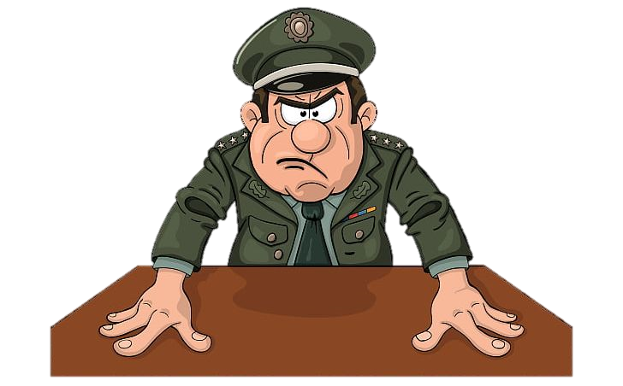
Any Question?

Slide 17
CHECK ON LEARNING

Slide 18
SUMMARY
PURSUIT OF EXCELLENCE
PRIDE IN UNIFORM
DISCIPLINE
PROFESSIONALISM
ADHERENCE TO LAW
ADHERENCE TO AUTHORITY

Slide 19


